Slide 1
R-Ladies…. Linear, Logistic, and Cox Regression: When & How to Run in RStudio
Jacqueline Kueper, MSc
PhD student in Epidemiology (& Biostatistics)
Contact: jkueper@uwo.ca
December 5, 2017
Disclaimer: this talk will be given from the perspective of an epidemiologist.

Slide 2
First….a little about you!
R experience?
Regression knowledge?

Slide 3
Outline
To maximize time in R, we will focus on broad concepts and minimize formulas…but I encourage you to look them up later.
General introduction to regression
Linear Regression
Logistic Regression
Choose our own adventure! In any order (time permitting):
Practice 1 & 2
Additional options for variables in regression models
Cox Proportional Hazards Regression
Notes:
Important to know when and why running regression.

Slide 4
What is regression?
We want to know what we are doing before we do it

Slide 5
What is regression?
Most generally, a statistical method that we can use to explore relationships between variables
Like all (most) models, regression models can be broadly thought of as a simplified version of reality.

Slide 6
Example: For adults living in London, is interest in statistics related to interest in learning R?
We assume that there is some (unknown) ’true’ relationship between interest in statistics and interest in learning R in our population of interest.

Slide 7
Terminology re: Variables
Example: Is interest in statistics related to interest in learning R?
Regression can be used to explore how our outcome varies as a function of our explanatory variable(s)
Interest in statistics
Interest in learning R
Explanatory variable, covariates, predictor, independent variable, X
Outcome, dependent variable, Y
Note: Not making any causal assumptions here (or at any point during this session)!

Slide 8
Example: For adults living in London, is interest in statistics related to interest in learning R?
We can use regression to estimate:
Whether interest and R are associated (statistical significance)

Slide 9
Example: For adults living in London, is interest in statistics related to interest in learning R?
We can use regression to estimate:
Whether interest and R are associated (statistical significance)
Strength of the relationship

Slide 10
Example: For adults living in London, is interest in statistics related to interest in learning R?
We can use regression to estimate:
Whether interest and R are associated (statistical significance)
Strength of the relationship
Whether an association remains if we adjust for other variable(s) (e.g. interest in research)

Slide 11
Example: For adults living in London, is interest in statistics related to interest in learning R?
We can use regression to estimate:
Whether interest and R are associated (statistical significance)
Strength of the relationship
Whether an association remains if we adjust for other variable(s) (e.g. interest in research)
The expected level of interest in learning R for a given level of interest in statistics.
And much more!

Slide 12
What type of regression model to use?
Depends on the type of outcome variable
All of these models can accommodate different types of explanatory variables (e.g. continuous, binary, categorical)
Can be 1 or more explanatory variable
These models are our interest for tonight, but many more options exist!
Outcome Variable | Model
Continuous | Linear
Binary | Logistic
Time-to-event | Cox Proportional Hazards
Notes:
Note there are regression models for other types of outcome variables, and other types of regression for these outcome variables.

Slide 13
Simple Linear Regression
Continuous outcome variable

Slide 14
Simple Linear Regression
Variables: 1 continuous outcome, 1 explanatory

Slide 15
Simple Linear Regression
There is some unknown ‘true’ relationship between X and Y that we assume can be approximated using a linear function:
Y = β₀ + β₁*X₁ + e
β_{i} : model “coefficient” or “parameter”
e : ”error” term
Notes:
This is what describes a regression line
Y – interest in R
X – interest in statistics
E – error bc we don’t assume that X accounts for all of the variability in R. Essentially represents what is missed by the model (non-linear relationship, missing variables that are responsible for variability in Y, measurement error)

Slide 16
Example: Is interest in statistics related to interest in learning R among adults living in London?
Population
(Adults in London)
Y = f(x) + e
Pretend that we obtained a random sample of our population of interest
Sample (data we can analyze)

Slide 17
Is interest in statistics related to interest in learning R?
We plot our data:
Outcome
Variable
Note: this is not actually data on stats/R. It’s about cats….
Explanatory Variable
Notes:
What can we see from this plot?
It looks like as interest in statistics increases, interest in learning R also increases. This looks approximately linear relationship.

Slide 18
Is interest in statistics related to interest in learning R?
We can estimate the population model parameters by fitting a regression model with data that represents our population of interest
Outcome
Variable
Explanatory Variable
We will talk about the grey shaded region around the regression line later.
Notes:
Previously outcome and explanatory variables were technically interchangeable. Think of correlation - assessing strength of linear relationship between two variables.
For regression the outcome and explanatory variable matters.

Slide 19
Why that line? Why not these ones?
There are many possible lines that we could draw to try and describe this relationship. The options are overwhelming! How to choose?

Slide 20
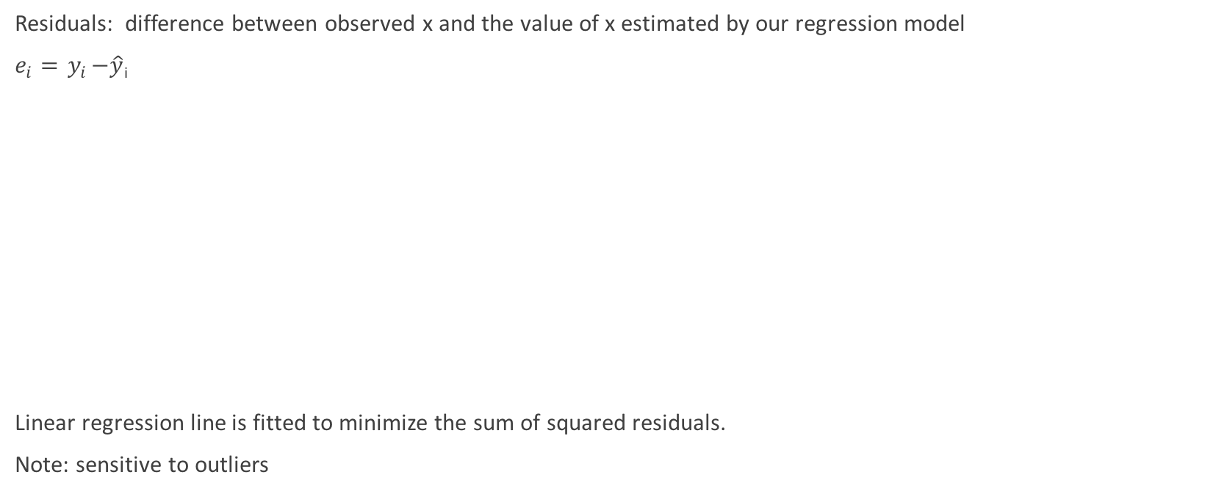
Ordinary Least Squares Regression
Residuals: difference between observed x and the value of x estimated by our regression model
$e_{i}={ y}_{i}−\hat{y}$_{i}
Linear regression line is fitted to minimize the sum of squared residuals.
Note: sensitive to outliers
Picture from: http://statstudent.tumblr.com/post/108699142671/simple-linear-regression-methods-ii-week-of
Notes:
We square the residuals because they average out to zero.
Minimizing the distance between our fitted regression line and the observed data points.

Slide 21
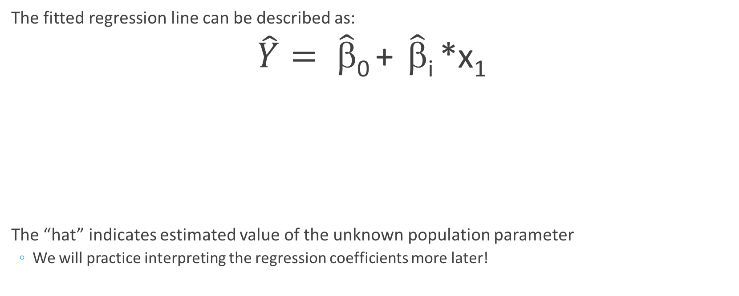
Simple Linear Regression
The fitted regression line can be described as:
$\hat{Y}= \hat{β}$₀ + $\hat{β}$_{i} *x₁
The “hat” indicates estimated value of the unknown population parameter
We will practice interpreting the regression coefficients more later!
Outcome
Slope
Intercept
Notes:
Intercept β₀ : expected value of Y when X = 0
Slope β₁ : expected/average change in Y associated with a one-unit increase in X
Our error term disappeared – is averages out in our fitted model.

Slide 22
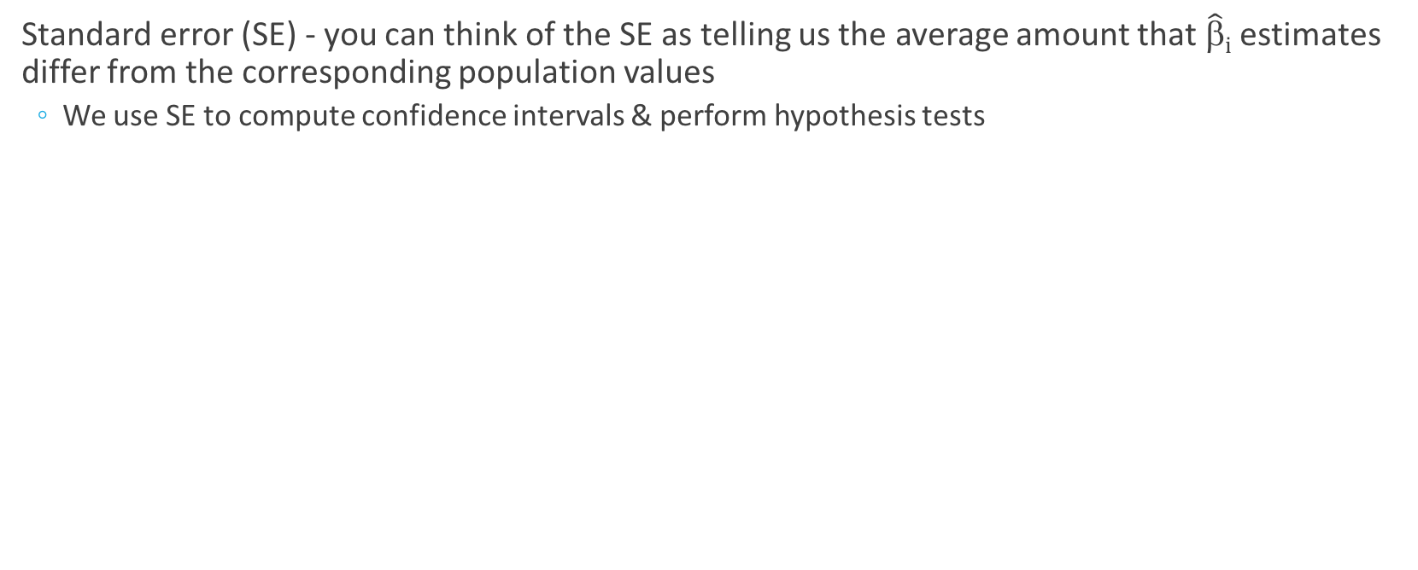
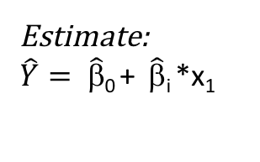
How close is our estimate to the population?
Standard error (SE) - you can think of the SE as telling us the average amount that $\hat{β}i$ estimates differ from the corresponding population values
We use SE to compute confidence intervals & perform hypothesis tests
Population
Y = f(x) + e
We usually only have one sample.
But if we repeated this process, our estimate would be a bit different each time. (Unbiased estimators)
Sample
Data that we analyze
Estimate:
$\hat{Y}= \hat{β}$₀ + $\hat{β}$_{i} *x₁
Notes:
The more data, less bias, etc will help make any given regression line close to the truth.
Can use SE to assess precision of estimates.
If assumptions hold, these regression coefficients are unbiased estimators of the population parameters (on average they are close to the population regression line; do not systematically over or under estimate the true parameter)

Slide 23
Assumptions of OLS Regression
Linearity
linear relationship between outcome and explanatory variables
Residuals are independent
Each observations does not influence any other observation
Argue by context
Homoscedasticity
Variance of the residuals is constant (given explanatory variables)
Residuals are normally distributed
Note: no distributional assumptions about explanatory variables.
Notes:
Assuming the error term is independent of x is a big assumption – there are often many variables related to X that are also related to Y and would improve model fit.
We often assume that explanatory variables are measured without error – this is often not the case! Think of reliability…

Slide 24
How to fit linear regression in R
lm function: “linear model” function
General structure:
lm(outcome ~ explanatory variable, data = df)
Missing data
Na.action = ‘option’
Default is na.omit – complete case removal
You should have a plan for missing data before performing regression

Slide 25
Example! With Cats!
Research question: For adult cats, is body weight associated with heart weight?
Simple linear regression
Outcome: Heart weight (continuous, g)
Explanatory variable: Body weight (continuous, kg)

Slide 26
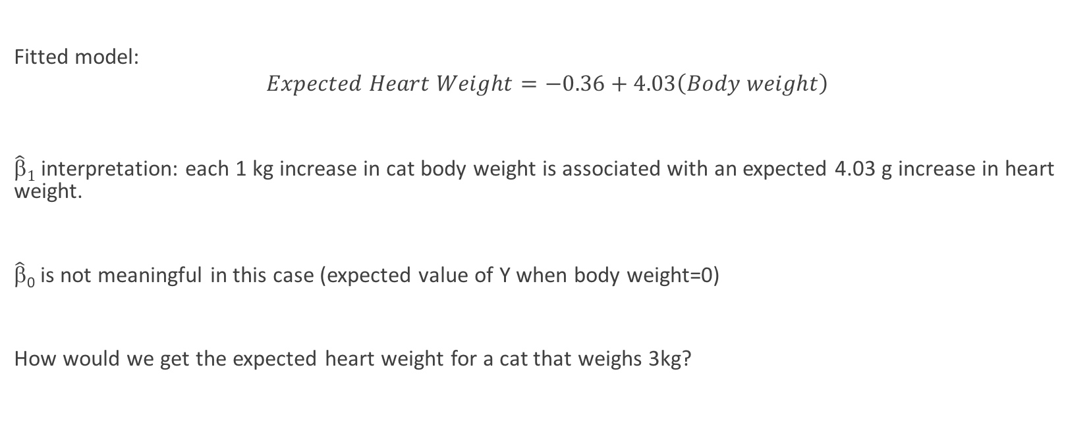
Cat Example – Simple Linear Regression
Fitted model:
$$Expected Heart Weight=−0.36+4.03\left(Body weight\right)$$
$\hat{β}1$ interpretation: each 1 kg increase in cat body weight is associated with an expected 4.03 g increase in heart weight.
$\hat{β}$₀ is not meaningful in this case (expected value of Y when body weight=0)
How would we get the expected heart weight for a cat that weighs 3kg?

Slide 27
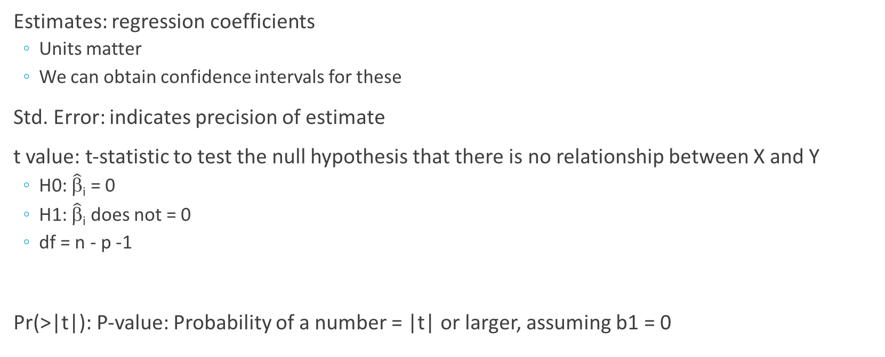
Summary(mod1_slr) – Coefficient estimates
Estimates: regression coefficients
Units matter
We can obtain confidence intervals for these
Std. Error: indicates precision of estimate
t value: t-statistic to test the null hypothesis that there is no relationship between X and Y
H0: $\hat{β}$_{i} = 0
H1: $\hat{β}$_{i} does not = 0
df = n - p -1
Pr(>|t|): P-value: Probability of a number = |t| or larger, assuming b1 = 0

Slide 28
Summary(mod1_slr) – Model fit
RSE = RMSE: Average amount that the response will deviate from the true regression line in units of outcome variable.
R-squared: Proportion of variability in Y that is explained by our model
Range: 0 to 1 (closer to 1 is better)
Independent of the scale of Y
For simple linear regression r^2 = R-square
Adding variables (multiple linear regression) will increase R-square – be cautious of overfitting
F-statistic: Ratio of the variance explained by parameters in the model to the unexplained variance (residuals)
Anova test statistic
“Good” model fit depends on the context

Slide 29
Multiple Linear Regression
Aka Multivariable Regression

Slide 30
Multivariable Regression
Variables: 1 continuous outcome, > 1 explanatory
Y = β₀ + β₁*X₁ + β₂*X₂ +…+ β_{p}*X_{p} + e
β_{i} interpretation: average effect on Y of a one unit increase in X_{i,} adjusting for all other explanatory variables.
Each explanatory variable gets its own regression coefficient
β_{i} interpretation: average value of Y when all X’s = 0.

Slide 31
Uses of Multiple Regression?
Try to isolate the effect of one variable on the outcome (e.g. etiology studies)
Prediction (diagnostic or prognostic)
Exploratory risk factor analysis
Investigate effect modification (interaction)
And more!
These all have different priorities in terms of the explanatory variables we decide to add to our model. Make sure you think about what you are doing before running regression (or any analysis)!
These are not specific to linear regression

Slide 32
Why don’t we always add all available variables to our model?
Adding variables to linear regression will increase R-Square
That’s good, right? Not necessarily!
You may be obtaining a better fit for your data (explain more variability in outcome), but this may reduce the ability to apply your model to other data (remember when we took a sample from our population?)
Adding variables can introduce bias, accidentally adjust for part of the effect of an explanatory variable of interest, lead to overfitting, etc.
How picky you are about what and how many variables you add to your model depends on the context
Notes:
There are also limits on how many observations you need wrt number of variables, in order for the fitting process to be possible.

Slide 33
Ex. of when adding a variable does harm
We are interested in the effect of interest in statistics on interest in learning R
Interest in statistics
Interest in learning R

Slide 34
Ex. of when adding a variable does harm
We are interested in the magnitude of the association between interest in statistics and interest in learning R
Population Model
Regression Model
Reading stats blogs
Interest in statistics
Reading stats blogs
Interest in learning R
Interest in statistics
Interest in learning R
Notes:
Maybe we mistakenly think reading stats blogs is a confounder.
Underestimate.
This only matters in some cases. Eg prediction where we are interested in estimated outcome value, not value of beta coefficient, it would be fine to put both explanatory variables in the model at the same time.

Slide 35
Cat Example - Continued
Maybe some of the association between body weight and heart weight is due to sex of cats (‘potential confounder’).
We want to know the effect of body weight on heart weight, after adjusting for sex of cats.
Sex
Body Weight
Heart Weight
?
Notes:
Note this is a ’classical’ definition of confounding

Slide 36
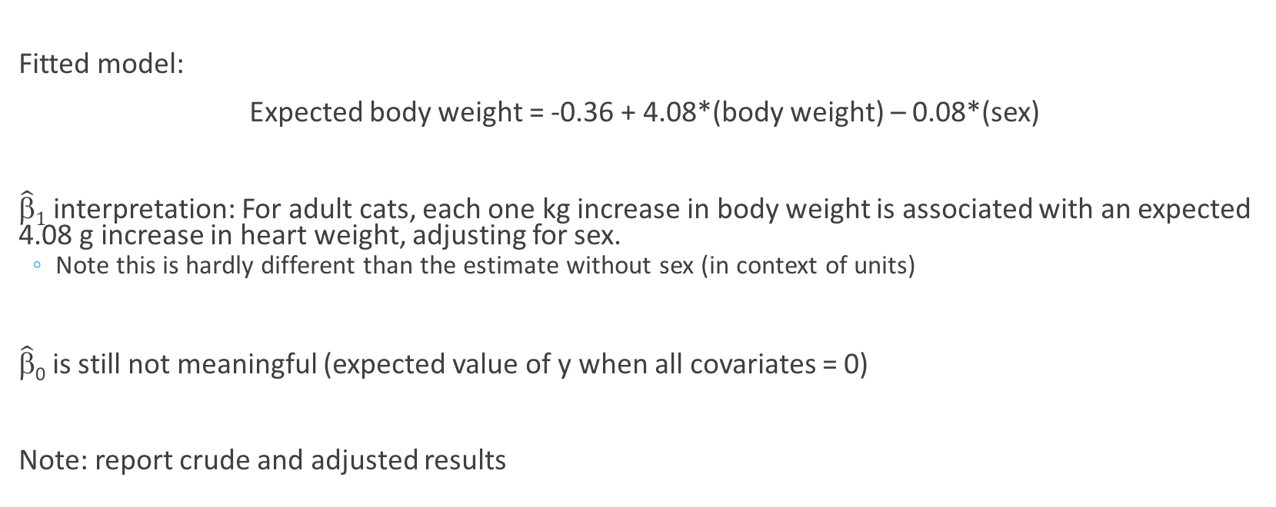
Cat Example – Multiple Linear Regression
Fitted model:
Expected body weight = -0.36 + 4.08*(body weight) – 0.08*(sex)
$\hat{β}1$ interpretation: For adult cats, each one kg increase in body weight is associated with an expected 4.08 g increase in heart weight, adjusting for sex.
Note this is hardly different than the estimate without sex (in context of units)
$\hat{β}$₀ is still not meaningful (expected value of y when all covariates = 0)
Note: report crude and adjusted results

Slide 37
Logistic Regression
Binary Outcome

Slide 38
Logistic Regression
Binary outcome: can take on values 1 or 0
E.g. Alive (0) or Dead (1 = event) at the end of an observation period
Models the probability of an event (Y=1) as a function of one or more explanatory variables.
Uh oh, this is not linear.
http://4.bp.blogspot.com/-xo71DTOBR7I/VFvcnyQ6f-I/AAAAAAAADU8/pFAMSKzOEoI/s1600/logistic%2Breg.png
Notes:
We can categorizing a continuous variable, but this decreases info.
Outcome variable follows a binomial distribution
Probability of observing x ‘events’ out of n independent trials

Slide 39
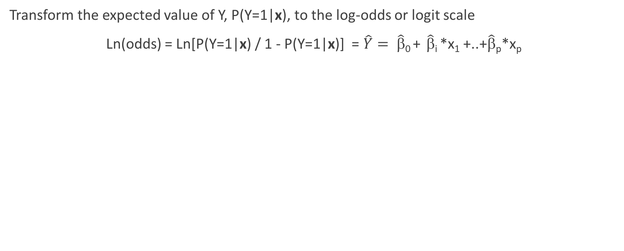
The link function
Transform the expected value of Y, P(Y=1|x), to the log-odds or logit scale
Ln(odds) = Ln[P(Y=1|x) / 1 - P(Y=1|x)] = $\hat{Y}= \hat{β}$₀ + $\hat{β}$_{i} *x₁ +..+$\hat{β}$_{p}*x_{p}
But this is!
https://support.bccvl.org.au/support/solutions/articles/6000083213-generalized-linear-model
Notes:
Bold indicates all x values

Slide 40
Generalized Linear Models
Extends the assumptions of normally distributed residuals and linear relationship between outcome variable and explanatory variables that we saw with linear regression
We still assume errors are independent
Distribution of the residuals belongs to a family of distributions (‘exponential family’)
E.g. binomial family
For each distribution there is at least one function (“link function”) of the mean whose relationship with model parameters is linear
Select link function based on distribution of outcome variable
E.g. Logit transformation of a binary outcome variable can have a linear relationship with the explanatory variables

Slide 41
Glm function in ‘stats’ package
General structure:
glm(outcome ~ explanatory variable, family = “binomial”, data = df)
Select ’family’ to specify choice of residual distribution and link functions
Families: Gaussian, Binomial, Poisson, and more!
We will focus on binomial distribution with a logit link function (default)
We can change the link function, e.g. specify: family=binomial(link=“probit”)
Fit by maximum likelihood estimation
Iterative process to find values of coefficients that result in a model where you would be most likely to get the observed results, i.e. P(Y|x)
(note the ‘start’, ‘etastart’, and ‘mustart’ arguments are basically ways to specify where you want the fitting process to start. The default selects a random starting point – this is what we will use).
Notes:
Fisher scoring is the default MLE in R.

Slide 42
Wait, I’m confused!
Why didn’t we fit our ‘linear models’ using ‘generalized linear models’???
We can!
The algorithm R uses to obtain our regression coefficients will be different (OLS vs. MLE), but the regression coefficients should be equivalent.
Not convinced? Let’s try in R. Remember the cats….

Slide 43
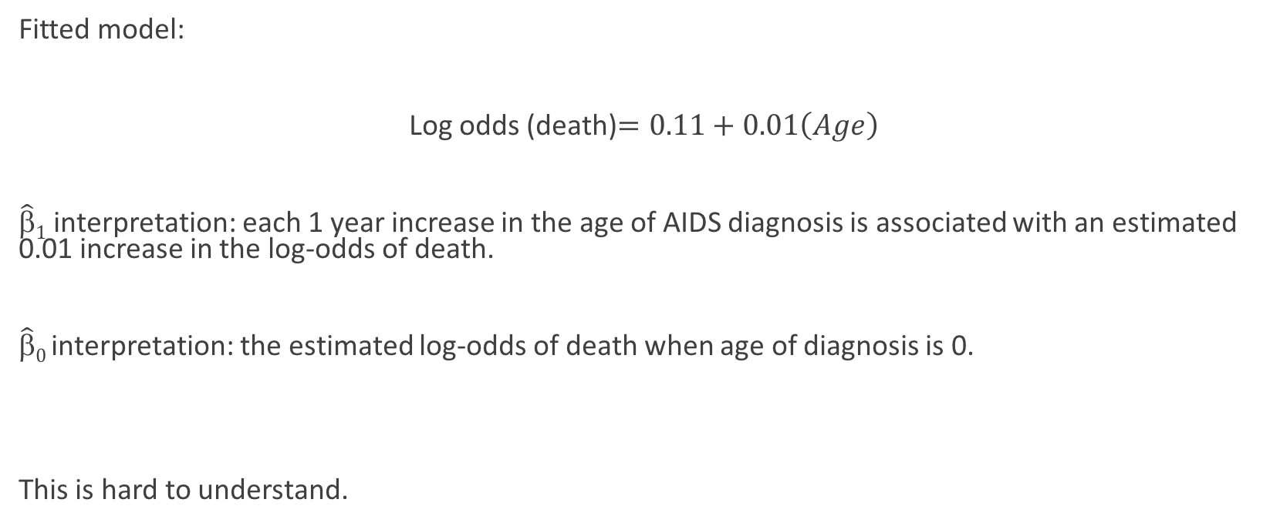
AIDS Survival Example - Logistic Regression
Fitted model:
Log odds (death)$=0.11+0.01\left(Age\right)$
$\hat{β}1$ interpretation: each 1 year increase in the age of AIDS diagnosis is associated with an estimated 0.01 increase in the log-odds of death.
$\hat{β}0$ interpretation: the estimated log-odds of death when age of diagnosis is 0.
This is hard to understand.
Notes:
We could also use our regression equation to obtain ORs and probabilities.

Slide 44
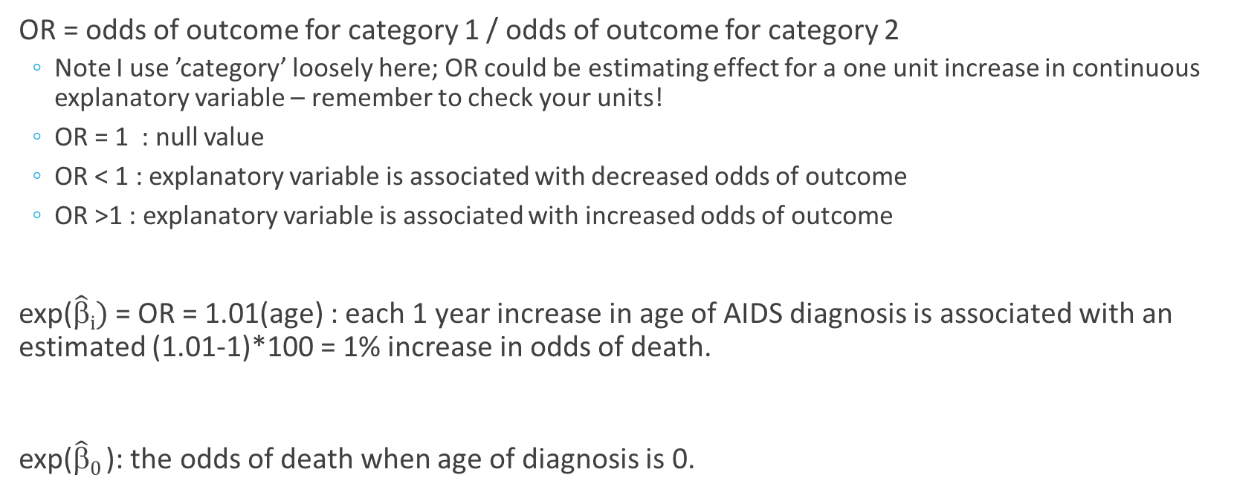
Convert coefficient estimates to Odds Ratios
OR = odds of outcome for category 1 / odds of outcome for category 2
Note I use ’category’ loosely here; OR could be estimating effect for a one unit increase in continuous explanatory variable – remember to check your units!
OR = 1 : null value
OR < 1 : explanatory variable is associated with decreased odds of outcome
OR >1 : explanatory variable is associated with increased odds of outcome
exp($\hat{β}i)$ = OR = 1.01(age) : each 1 year increase in age of AIDS diagnosis is associated with an estimated (1.01-1)*100 = 1% increase in odds of death.
exp($\hat{β}0$ ): the odds of death when age of diagnosis is 0.

Slide 45
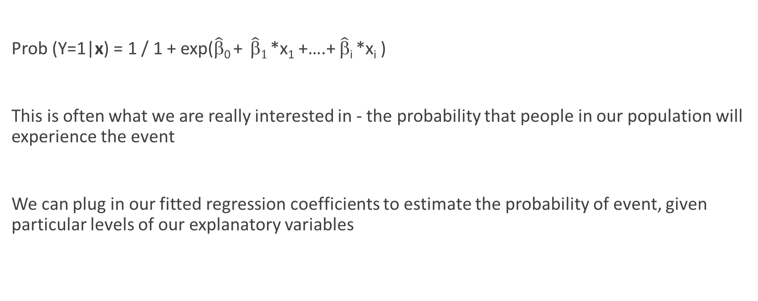
Obtain predicted probability of response
Prob (Y=1|x) = 1 / 1 + exp($\hat{β}$₀ + $\hat{β}1$ *x₁ +….+ $\hat{β}$_{i} *x_{i} )
This is often what we are really interested in - the probability that people in our population will experience the event
We can plug in our fitted regression coefficients to estimate the probability of event, given particular levels of our explanatory variables

Slide 46
General Steps to Regression
Clearly state question of interest.
Determine the type of outcome variable.
Select regression model.
Check data, clean, missing values, plot, etc.
Ensure categorical variable(s) are coded as desired (if applicable).
For the function that you use in R, change default options if needed.
Run univariate model.
Run multivariate model (if applicable).
Check model fit.
Interpret results.

Slide 47
Option!
Practice?
Cox Proportional Hazards Regression?
Explore more options for fitting models (e.g. centering explanatory variables)?

Slide 48
Cox Proportional Hazards Model
Time-to-Event Outcome

Slide 49
Survival analysis
’Survival’ indicates time spent without outcome of interest.
Sample questions:
Probability that a person will survive 5 years?
Does a group receiving treatment A have a different survival than a group receiving treatment B?
How does stress affect one’s changes of survival?

Slide 50
Time to event data
https://www.google.ca/url?sa=i&rct=j&q=&esrc=s&source=images&cd=&cad=rja&uact=8&ved=0ahUKEwjX17D1wfHXAhVDNd8KHYB3C8sQjRwIBw&url=https%3A%2F%2Fk-d-w.org%2Fnode%2F97&psig=AOvVaw1TJrEh9OkMm__5ZUuA5pEm&ust=1512516580965419
Notes:
Logistic regression – we would analyze number of events as dichotomous outcome. Likely exclude loss to follow-up.
Survival analysis allows us to also take into account the follow-up time of each individual
Time of origin/time 0 = time when ppl considered at risk of outcome. Often study baseline

Slide 51
Survival Curve
Log rank test - null hypothesis is that there is no difference in survival between two or more independent groups
Compares entire survival experience

Slide 52
Cox Proportional Hazards Regression
Outcome: time-to-event data
Time until subject has experiences an event (could be anything)
Ex: Number of years until death in a longitudinal study
Always positive, often skewed distribution
Can take into account censoring
E.g. People who drop out of a research study before it is over, people/observations that have not experienced the event by the end of a follow-up period (right censoring)
In logistic regression, people lost to follow-up do not contribute towards estimates
Can have one or more explanatory variable (categorical or continuous)
E.g. treatment group, age
Kaplan-Meier curves and log rank tests are only useful for one categorical explanatory variable.

Slide 53
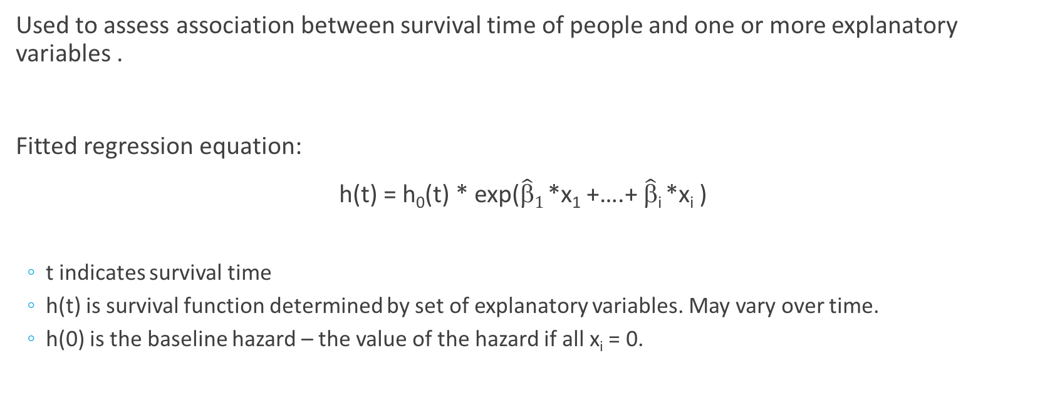
Cox Proportional Hazards Regression
Used to assess association between survival time of people and one or more explanatory variables .
Fitted regression equation:
h(t) = h₀(t) * exp($\hat{β}1$ *x₁ +….+ $\hat{β}$_{i} *x_{i} )
t indicates survival time
h(t) is survival function determined by set of explanatory variables. May vary over time.
h(0) is the baseline hazard – the value of the hazard if all x_{i} = 0.

Slide 54
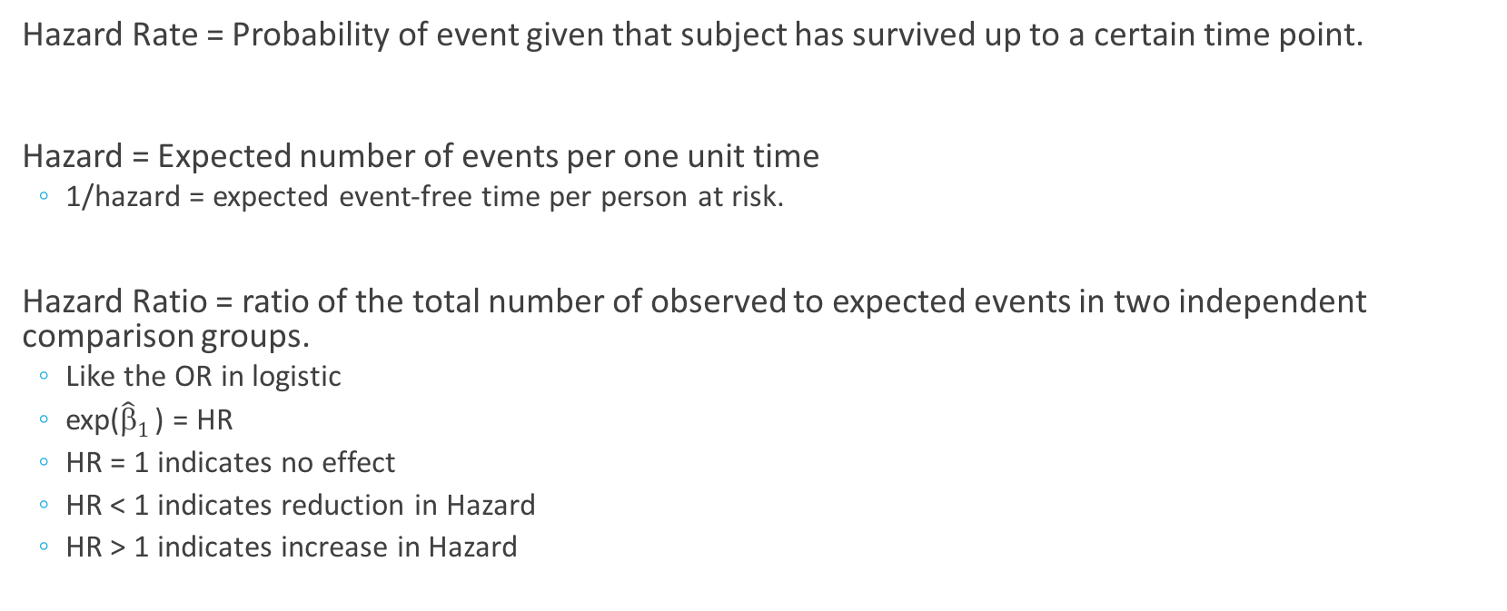
Cox PH Regression Estimates
Hazard Rate = Probability of event given that subject has survived up to a certain time point.
Hazard = Expected number of events per one unit time
1/hazard = expected event-free time per person at risk.
Hazard Ratio = ratio of the total number of observed to expected events in two independent comparison groups.
Like the OR in logistic
exp($\hat{β}1$) = HR
HR = 1 indicates no effect
HR < 1 indicates reduction in Hazard
HR > 1 indicates increase in Hazard

Slide 55
Assumptions for Cox Regression
Censoring is independent to likelihood of developing an event of interest
Proportionality – assume hazards are proportional over time
Assess using Schoenfeld residuals
Cox.zph() function in ‘survival’ package.
Linearity in relationship between log hazard and covariates
Assess using Martingale residuals
Avoid influential observations
Assess using Deviance residuals

Slide 56
Other things to consider

Slide 57
Explanatory Variables
Units (meaningful interpretation?)
Centering
Standardization
Polynomial terms
Application of our regression models

Slide 58
Standardized Coefficients
Regression coefficients are expressed in the units of the explanatory variable
The regression coefficient for a variable measured on a scale of 0 to 100 is not directly comparable with that of a variable measured on a scale of 1 to 10
Standardization allows comparison in terms of SD units
A word of caution
Sometimes standardization hinders interpretation, e.g. age
We can compare standardized coefficients WITHIN but not BETWEEN studies
Group differences in the variances of y and x make standardized effects different across groups even when the unstandardized effects are the same.
Notes:
Can standardize wrt X, Y, or X and Y
StdX(beta1) – change in y when x changes one standard deviation
StdY(beta1) – change in y standard deviation units
StdYX(beta1) – change in y standard deviation units when X changes one standard deviation
If dichotomous covariate, would only make sense to standardize wrt Y so that stdY(beta1) – the change in y standard deviation units for a change in the covariate from 0 to 1

Slide 59
Centering
Unless interested in prediction, the intercept is often not super important
E.g. if x=0 not possible
Can center covariate to make the intercept more meaningful
Subtract mean from each observed value of explanatory variable

Slide 60
Interaction / Effect Modification
http://lh4.ggpht.com/-sOH4146CDSc/TluC1FNYuGI/AAAAAAAAA6A/GHCCiieg3QE/ancova-fig-2_thumb%25255B6%25255D.jpg?imgmax=800
Notes:
Additive vs. multiplicative scale.
Synergistic vs antagonistic vs qualitative.

Slide 61
Practice

Slide 62
Practice
We will use ‘birthwt’ data from the ‘MASS’ package
1. Is there an association between the weight of a baby and their mother’s weight during her last menstrual period?
Hint: start with ??birthwt
2. What is the probability of having a baby weighing less than 2.5kg for a mother who is 25 years old, smoked during pregnancy, and has no history of hypertension?

